Slide 1

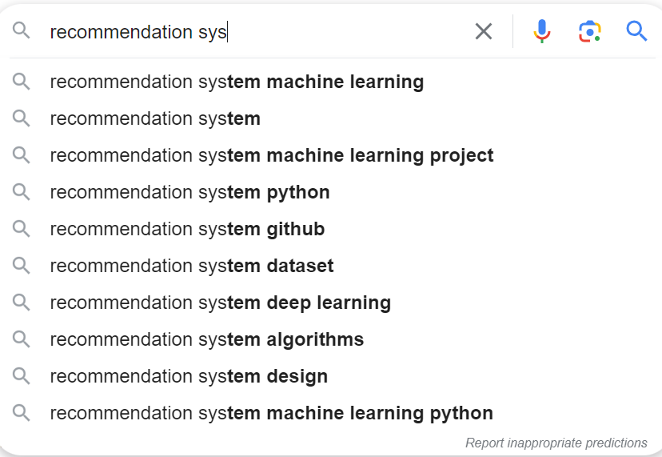
Recommendation systems

Slide 2
P-279 (Book Recommendation) Ai Variant
GROUP 4

Slide 3
content
What id recommendation system ?
Applications?
Project Objective
Project Milestone
EDA
Data Cleaning
Modeling and Evaluation
Fetching Recommendations

Slide 4
What is a Recommender System ?
A recommender system is a system that is used to make prediction about the user preference
Examples of such applications include recommending products on Amazon, music on Spotify, and of course, stories on Medium. The famous The Netflix Prize is also a competition in the context of recommendation systems.

Slide 5

APPLICATIONS

Slide 6
APPLICATIONS
Movie recommendation in Netflix
Related products recommendation in Amazon
Web page ranking in Google
Friends recommendation in social networks eg. Facebook
News content recommendation in Yahoo News
Priorities Inbox and Spam mail filtering
Computational advertising in Yahoo
Online dating Sites

Slide 7
WHY?
To push content
More user engagement
To improve user ‘s experience
Providing user aid
Auto completion
Auto correction
Resource Friendly
Product Promotion

Slide 8
PROJECT GOAL
The main objective is to create a recommendation system to recommend relevant books to users
3 datasets : Books , User and Ratings

Slide 9
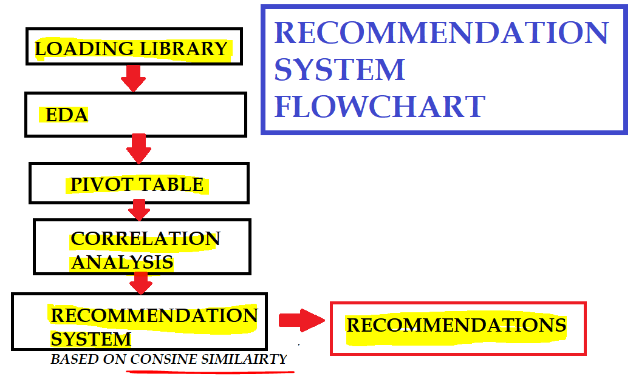

Slide 10
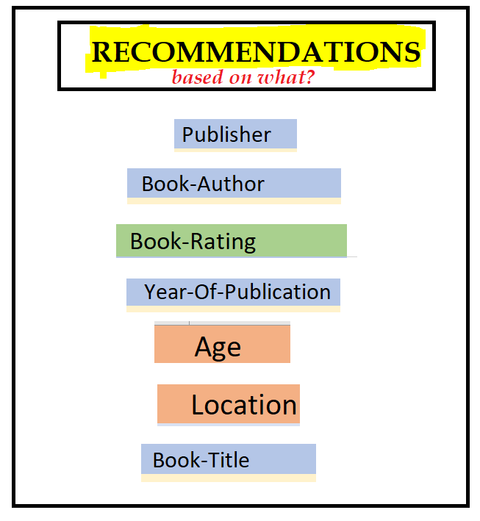

Slide 11
PROJECT MILESTONES
WEEK 1 : EDA
WEEK 2 : DATA WRANGLING
WEEK 3 : MODELING
WEEK 4 : DEPLOYMENT

Slide 12


Slide 13
DATASET ANALYSIS
BOOKS DATASET | USER DATASET | RATINGS DATASET
●ISBN (unique for each book) ●Book-Title ●Book-Author ●Year-Of-Publication ●Publisher ●Image-URL-S ●Image-URL-M ●Image-URL-L ●Shape of Dataset - (271360, 8) | ●User-ID (unique for each user) ●Location (contains city, state and country separated by commas) ●Age Shape of Dataset - (278858, 3) | ●User-ID ●ISBN ●Book-Rating ●Shape of Dataset -(1149780, 3)

Slide 14
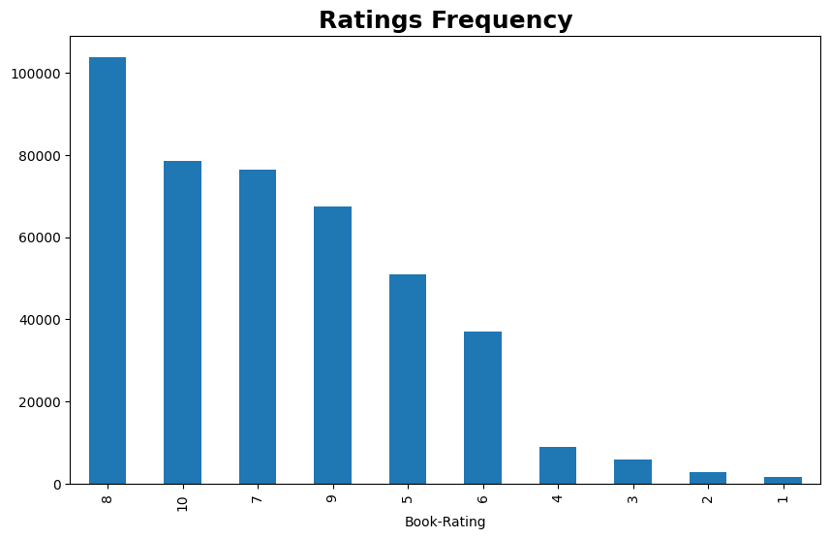
Observations from Ratings DATASET (Books_Ratings)

Slide 15
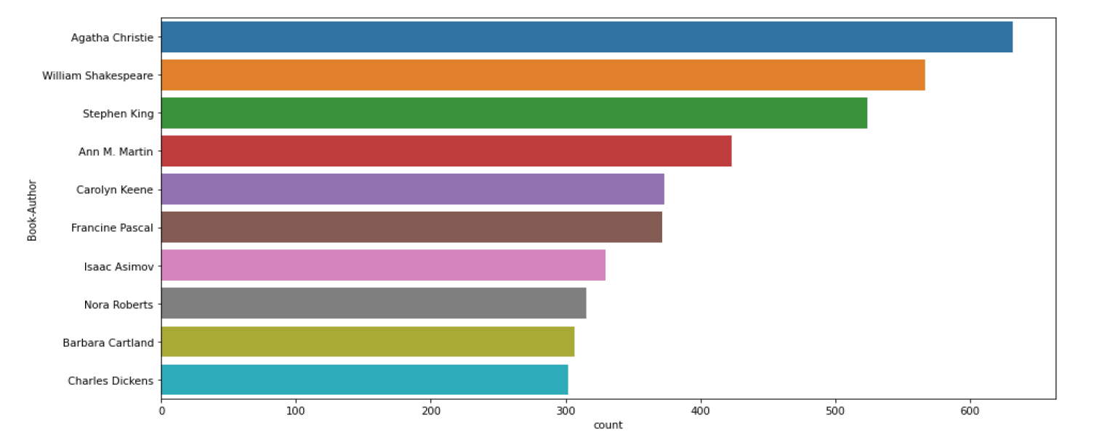
Observations from Book dataset (Authors)

Slide 16
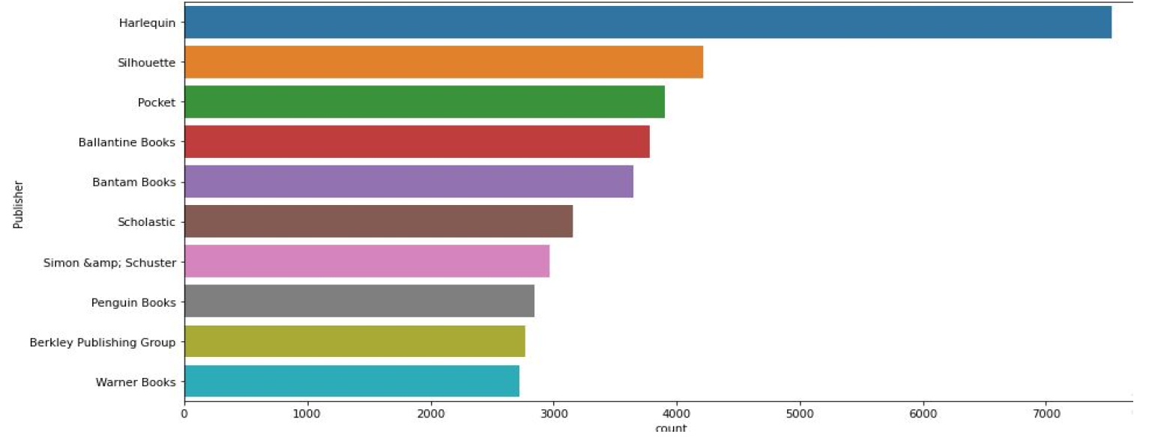
Observations from Book DATASET (Publishers)

Slide 17
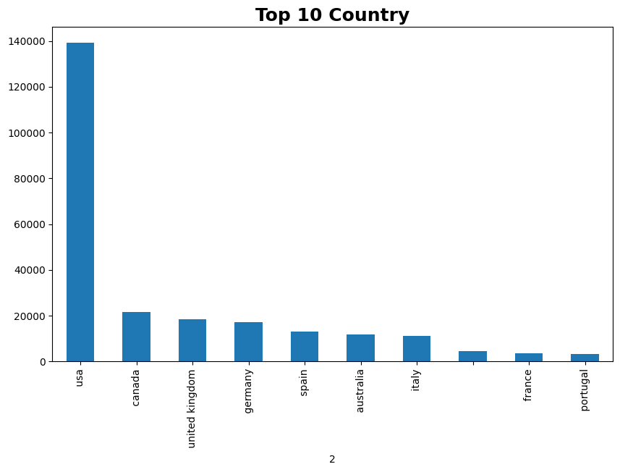

Slide 18
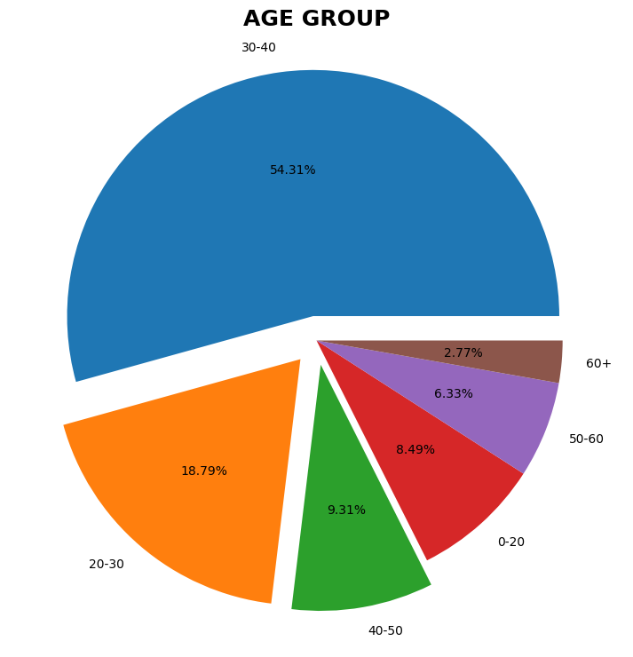
Most user of age group 30-40
More than 50 %
2nd major Gorup is 20-30
20-40 age group takes upto 70%

Slide 19
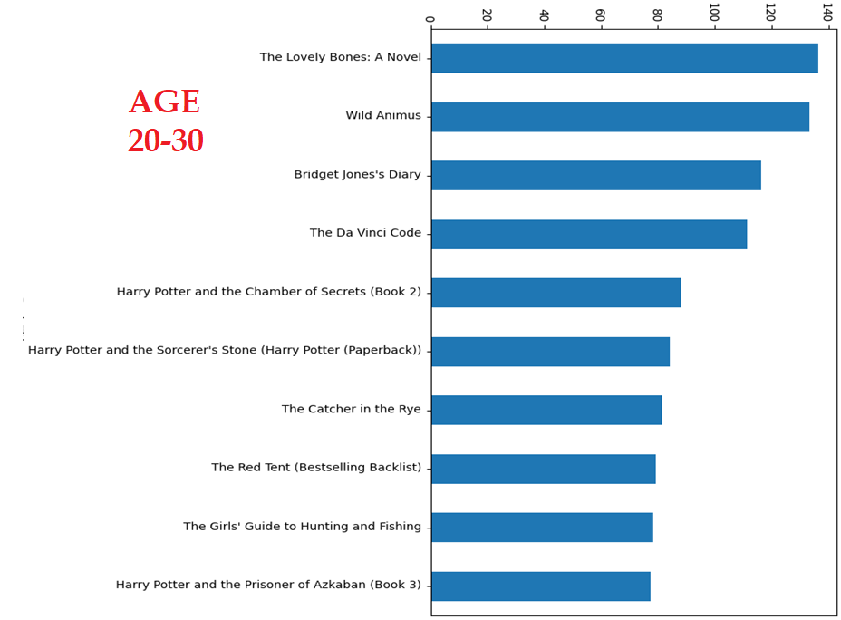

Slide 20
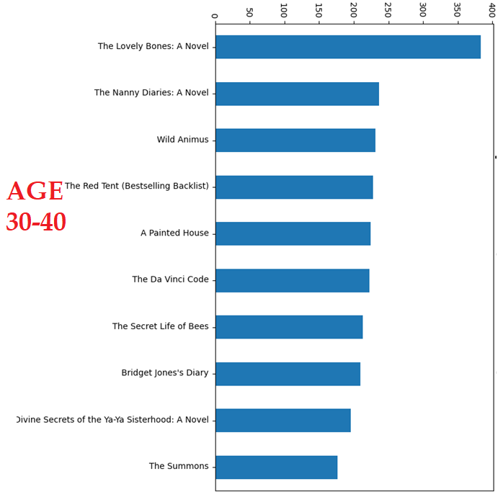

Slide 21
DATA CLEANING
BOOKS DATASET | USER DATASET | RATINGS DATASET
● only 3 missing values ● dropping | ● Age – 40% missing values ●Outliers in Age column ●Age has positive Skewness (right tail) so we can use median to fill Nan values | ●most of ratings filled with zero ●Book-Rating – 65% missing values

Slide 22
Data Cleaning cont..
Number of Unique Book Authors are 102023
Number of Unique Books are 242135
user unique geolocation : 57339
Age : so many missing values
measures taken for Age Attribute : Drop
difficult to perform recommendations based on AGE of users

Slide 23

MEASURE FOR SPARSITY

Slide 24
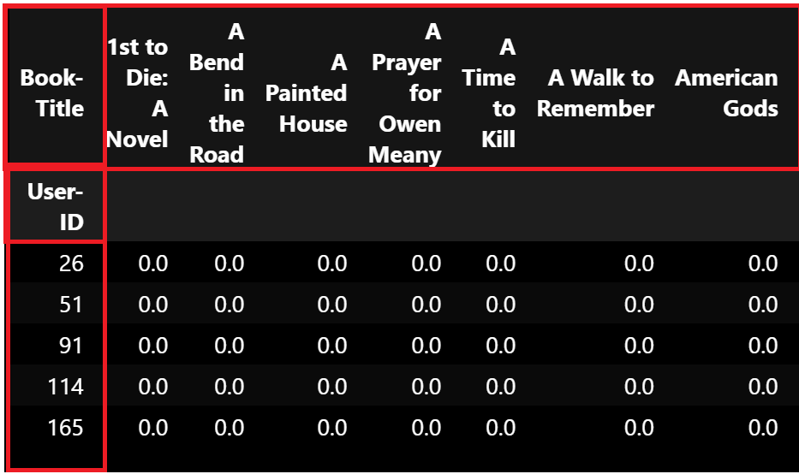
UTILITY MATRIX

Slide 25
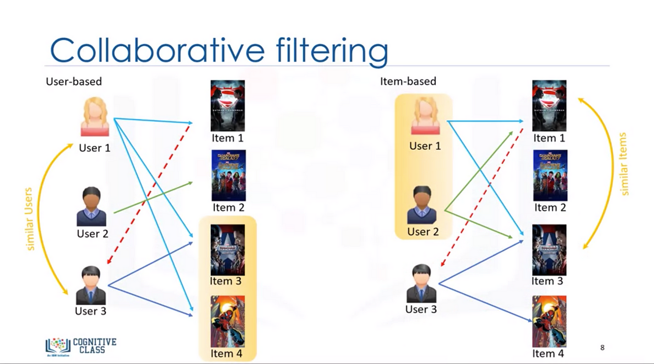

Slide 26
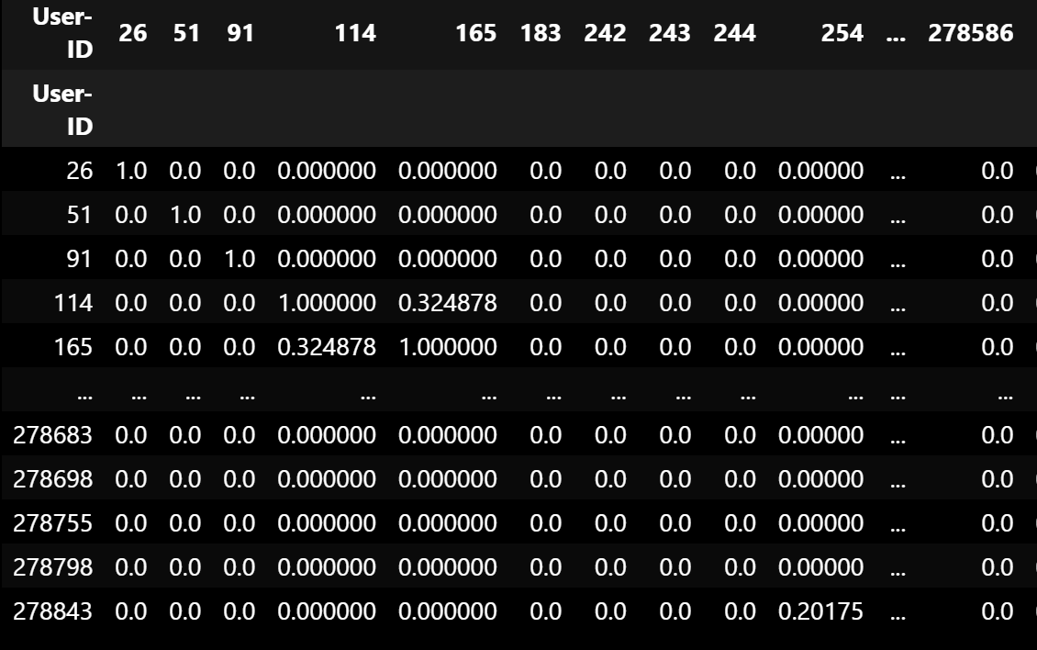
User-User-Based Collaborative Filtering

Slide 27
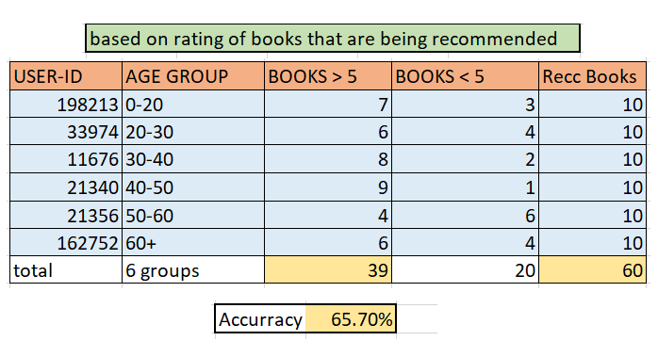
USER-USER EVALUATION

Slide 28
ITEM-ITEM-Based Collaborative Filtering

Slide 29
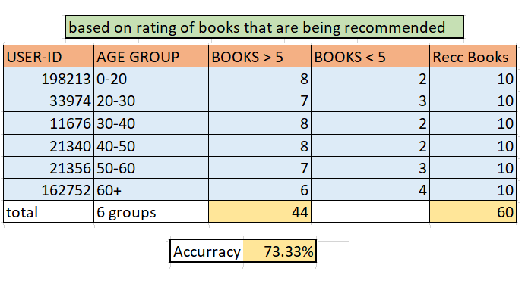
ITEM-ITEM EVALUATION

Slide 30


Slide 31
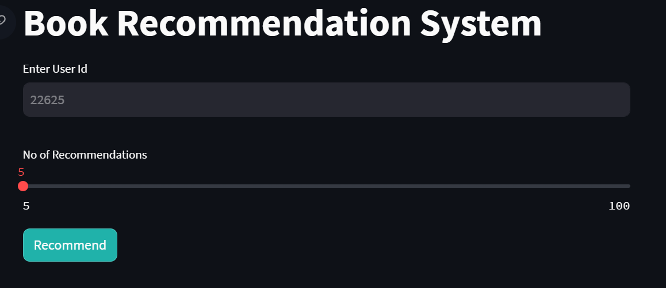
FETCHING RECOMMENDATIONS

Slide 32

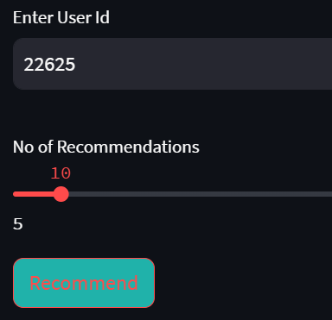

Slide 33
conclusion
In EDA, the Top 10 most rated books were essentially novels Books like The Lovely Bone and The Secret Life of Bees were very well perceived
Majority of th e readers were of the age bracket 20-40 and most of them from USA, Canada, UK, Germany and Spain
most of the books have high ratings with maximum books being rated 8 Ratings
Author with the most books was Agatha Christie, William Shakespeare and Stephen King

Slide 34
Challenges
Handling of sparsity was a major challenge
metric for evaluation
data cleaning was a major challenge in features like Location
missing value , outlier treatment was challenging as well

Slide 35
Future Scope
Given more information regarding the books dataset, namely features like Genre, Summary etc, we could implement a content filtering based recommendation
explore various clustering approaches wrt age groups and ratings
Predicting ratings

Slide 36


